Slide 1
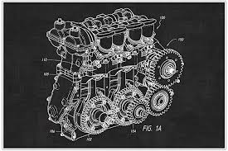

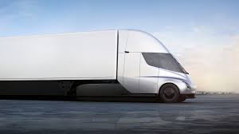


Cummins Innovation Hub
Engine Design for Hyundai C&E
Owner: AJ R.
Date: 12/9/2018
VR Innovation ounge
Owner: Angela M.
Date: 12/9/2018
Tesla Truck for Distribution
Owner: Teja D.
Date: 12/9/2018
29
19
13

Slide 2
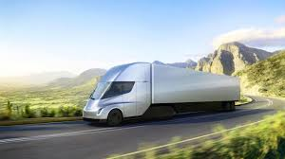
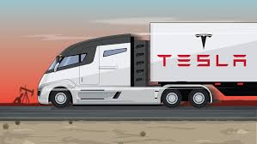
Cummins Innovation Hub
Tesla Truck for Distribution
13
Owner: Teja D.
Date: 12/9/2018
Description
Hi, I think it’d be better for the environment if we use electric trucks to distribute the engines. Tesla announced that they will start producing these in 2019 and I think it would be a great investment. What do you think?
Comment
Jiwon C. (Cummins, HR- Columbus, IN)
: Hi Teja, I think it is a great idea. I’d be happy to see Cummins taking green initiatives as an engine company!
Angela M. (Ford, Sourcing Analyst- Dearborn, MI)
: How would it impact the lead time? Would it increase the cost of delivery?
Aj R. (AK Steel, Distribution Manager –Livingston, MT)
: That looks cool.
Other Images

